Slide 1

Predicting Accident Severity in Great Britain
IBM Data Science Capstone
Anne Bode, September 2020

Slide 2
What’s the problem?
Certain everyday decisions come with a calculated risk, whether conscious or unconscious.
The decision to get behind the wheel of a car and drive (alongside fellow cars) at speeds upwards of 60 mph comes with an inherent risk.
However, more often than not we decide that the risk of getting into a fatal accident is outweighed by the reward of getting to where we need to be.
Some of these calculations prove to be woefully inaccurate, with the result a matter of life and death.

Slide 3
What’s the solution?
What if we could enhance our subconscious decision-making with a tool that would allow us to look out the window, contemplate our route, and decide whether we still like the odds?
A tool like the one described could both save lives and improve traffic conditions, by reducing our likelihood of getting into a fatal accident… and causing a bumper to bumper headache for fellow drivers while we are at it.
In this project, we look at accident severity data in Great Britain, specifically.

Slide 4
Dataset
The dataset used in this project is provided by the UK’s Department of Transport and can be found here.
The “Road Safety Data – Accidents 2018” CSV file includes data on personal injury road accidents in Great Britain between 2005 and 2018.
Additional information about the variables included in the dataset can be found here.
Our goal is to use certain variables to predict how severe an accident would be, should a particular driver get into one over the course of her or his drive.

Slide 5
Data Preparation
Non-predictive or overly specific features are dropped
Correlation run to determine which remaining features may have a relationship with our target variable (Accident_Severity)
Useless datapoints dropped
Data re-coded for ease of understanding, ahead of visualizations
Accident_Severity split into “Fatal” and “Non-Fatal”
Dataset balanced: “Fatal” upsampled and “Non-Fatal” undersampled

Slide 6
Data Exploration
We visualize our data in two ways per feature:
Stacked histogram of feature, with Accident_Severity labels stacked (differentiated by color)
Stacked percentage of Accident_Severity labels (differentiated by color) per feature value
Features:
Weather_Conditions
Light_Conditions
Speed_limit
Urban_or_Rural_Area

Slide 7
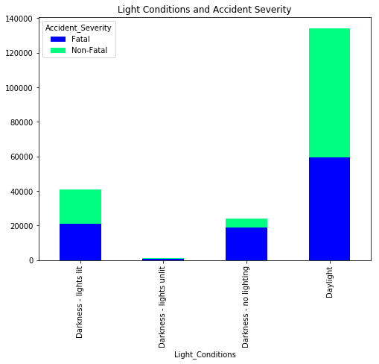
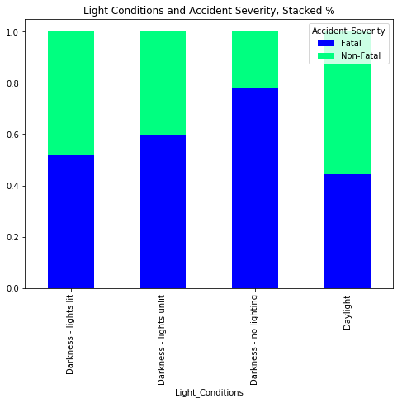
Data Visualization
Example:

Slide 8
Model Preparation
Features selected, one hot encoded
Dataset split into Train/Test datasets (80%/20%)
Logistic Regression model is selected
Why?: Size of dataset (200k datapoints) and relevance of probability (user will likely incorporate probability into decision-making process)

Slide 9
Modeling & Evaluating
Logistic Regression created with training data
Model then used to predict labels using test data
Results are then used to ascertain the performance of the model
Jaccard index, F1-score, LogLoss all calculated
Confusion matrix created to visualize model’s accuracy

Slide 10
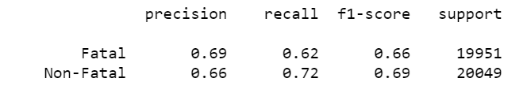
Results
Our model ultimately proved to be relatively accurate in predicting fatal vs. non-fatal accidents.
With a Jaccard index of 0.67, F1-score of 0.67, and LogLoss of 0.62, we can be reasonably satisfied.
However, there is still much room for error.

Slide 11
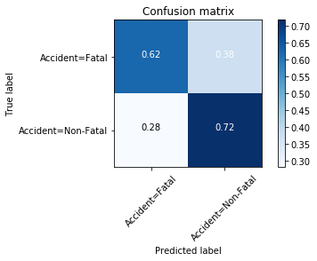
Confusion Matrix

Slide 12
User-Friendly Tool: Description
A user-friendly tool is created so that users can input expected conditions and receive a prediction on whether an accident they may get into would be fatal.
We model two scenarios:
One is a highspeed, nighttime, snowstorm drive through a rural neighborhood
The other is a slower, daytime, fair weather drive through an urban center
You can likely guess what the predicted accident severity will be!

Slide 13
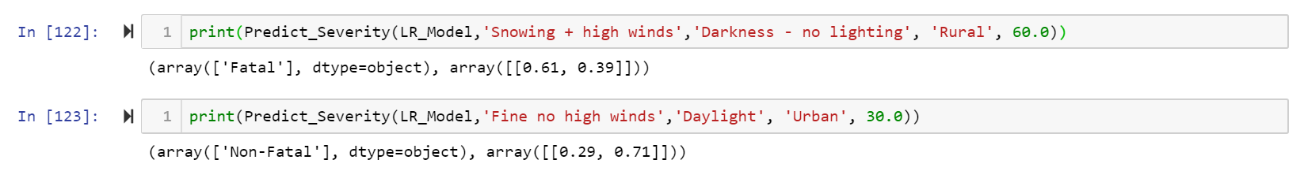
User-Friendly Tool Results
Our first scenario is predicted to be “Fatal” with a 61% probability.
Our second scenario is predicted to be “Non-Fatal” with a 71% probability.

Slide 14
Conclusion: Drive Safe!
Before embarking upon a road trip, a driver must weigh a number of factors when ascertaining the safety of such a trip.
Accidents are inherently difficult to predict, and so a driver must understand that this is a risk she or he is inevitably taking on.
However, given a large, labeled dataset of accident details, we can now better predict whether one of these “inevitable” accidents would result in a fatality.
Given a driver’s innate common sense, personal understanding of the route chosen, and a logistic regression model predicting that an accident would be “Non-Fatal”, the drivers of Great Britain can now face the unexpected with a bit more confidence.

